Slide 1
Debugging in Eclipse
Finding bugs the easy way

Slide 2

What are bugs?
It's an error, fault or mistake in a computer program
Lots of different things cause bugs...
Syntax errors (e.g. using '=' instead of '==')
Logical errors (e.g. infinite loops)
Mathematical operations leading to arithmetic overflow
Uninitialized variables
Null pointers

Slide 3

Ways to find them
We can fill our programs with System.out.println calls
Even better we can put lots of DEBUG and TRACE level logging messages into our code
Problem with debugging this way is that code becomes bloated with logging messages
Lots of work to write logging messages that display the values of all relevant variables

Slide 4
Debugging
Most modern languages such as Java allow applications to be run in a debug mode
This means we can watch each statement being executed, and verify that the code is functioning as we intended

Slide 5
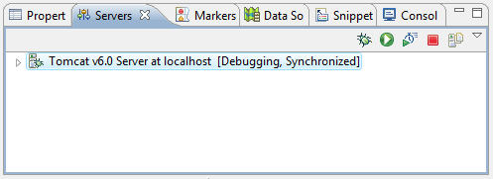
Debugging web applications
To launch a web application or servlet in debug mode, right-click on it and choose Debug As → Debug on Server
Or switch the server into debug mode...

Slide 6
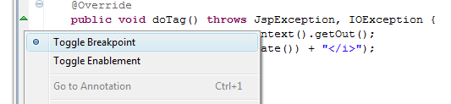
Breakpoints
These are markers which tell the JVM to pause the program's execution
While the program is paused, we can inspect the values of variables to see if the code is working as we intended

Slide 7

Breakpoints
When Eclipse hits a breakpoint, it will:
Open the Debug perspective (optional)
Highlight the current line

Slide 8
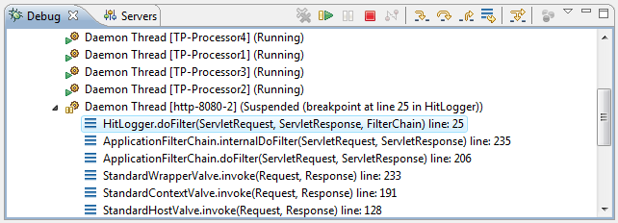
The debug view
The debug view lists the threads being debugged. It tells us:
Which thread reached the breakpoint
The call stack of that thread - i.e. it's history of method calls

Slide 9
Controlling execution
The debug view also provides controls to
Resume the program execution
Stop the program (i.e. end execution / debugging)
Step through the code

Slide 10
Stepping through code
Icon | Name | Key | Description
 | Step Into | F5 | If current line is a method call, debugger will move to the first line of that method
 | Step Over | F6 | If current line is a method call, debugger executes method and moves to next line
 | Step Return | F7 | Debugger finishes execution of current method, and moves to line of code that called the method
 | Drop to Frame |  | 'Rewinds' the program back to start of the current stack frame

Slide 11
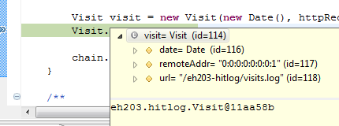
Inspecting variables
We can inspect the variables within the code to see what values they have
Hovering the mouse over a variable shows its value/members in a popup

Slide 12
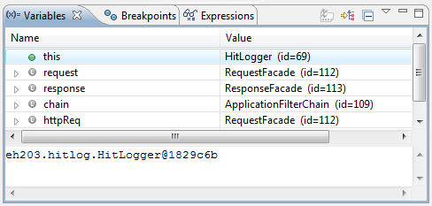
The variables view
This lists all of the variables in the current scope
We can even change values of variables

Slide 13
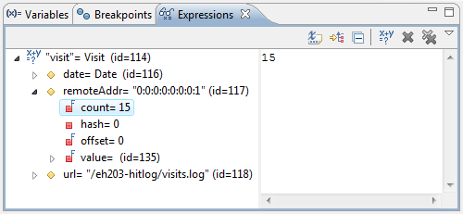
The expressions view
Variables in the variables view can be 'watched' which means they are added to the expressions view

Slide 14
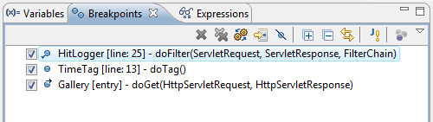
The breakpoints view
This lists all the breakpoints in the workspace
Makes it easy to enable and disable them
And edit a breakpoint's properties...

Slide 15
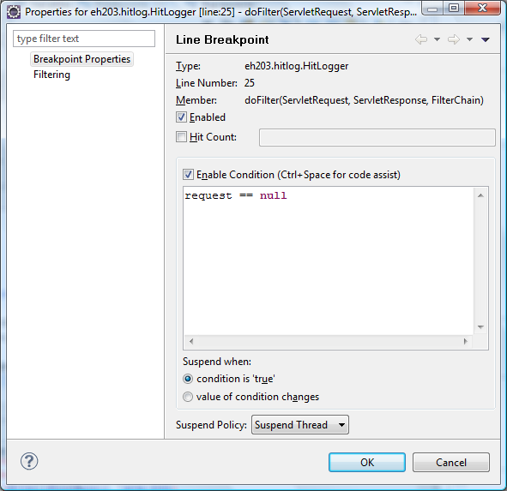
Breakpoint properties
This dialog lets us specify a condition for a breakpoint
We can tell eclipse to only suspend execution when the condition is true

Slide 16
References
Websites
http://www.ibm.com/developerworks/library/os-ecbug/

